Slide 1

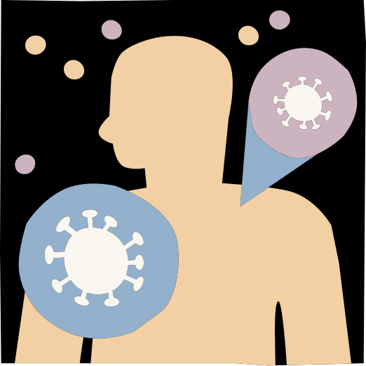









UNRAVELING THE GENETIC AND PATHWAY OVERLAP BETWEEN SARS-COV-2 AND ALZHEIMER’S DISEASE: INSIGHTS FOR FUTURE THERAPEUTIC STRATEGIES
Rana Kamel
Reem Sharaf
Mohamed Abdelkader
Alaa sharaf

Slide 2






INTRODUCTION
Alzheimer's disease is a progressive brain disorder and the leading cause of dementia, affecting memory and cognitive abilities. It deeply impacts patients and their caregivers, highlighting the need for awareness, better care, and advancements in treatment research.
COVID-19 is a global pandemic that affects respiratory health, highlighting the need for prevention, vaccination, and international cooperation to protect public health.

Slide 3





AIM AND OBJECTIVE
IDENTIFY THE COMMON GENETIC ELEMENTS AND MOLECULAR PATHWAYS SHARED BY ALZHEIMER'S DISEASE AND SARS-COV-2 INFECTION.

Slide 4
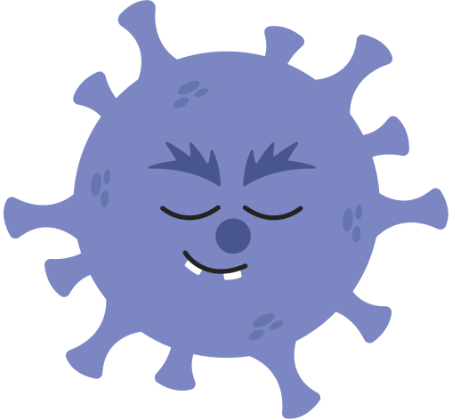



METHODOLGY
Data Collection and Preprocessing:
Datasets: Retrieved from Gene Expression Omnibus (GEO) database for RNA-seq analysis.
Studies: Focused on Alzheimer's disease (AD) and SARS-CoV-2 (COVID-19).
Samples: Selected 10 control and 10 illness samples for each dataset.
Analysis: Conducted Differential Expression Analysis (DEA) using GEO2R to identify DEGs for both diseases
Identification of Common Genes & ShinyGO Analysis
DEGs Comparison: Analyzed using R to find shared genes between AD and SARS-CoV-2 datasets.
ShinyGO: Functional annotation, phylogenetic tree construction, and gene enrichment analysis performed.
Focus: Identified biological roles and evolutionary links of common genes.

Slide 5



Methodolgy
Pathway Analysis:
KEGG Database: Used for pathway enrichment analysis of common genes.
Objective: Uncovered molecular pathways linking SARS-CoV-2 and AD.
Outcome: Revealed key pathways and mechanistic connections between neurodegeneration and viral infection
Statistical and Bioinformatics Validation:
Tools: Validated results from GEO2R, R, ShinyGO, and KEGG.
Criteria: Ensured accuracy using adjusted p-values and False Discovery Rates (FDR).
Goal: Strengthened genetic and molecular insights into SARS-CoV-2 and AD connections

Slide 6
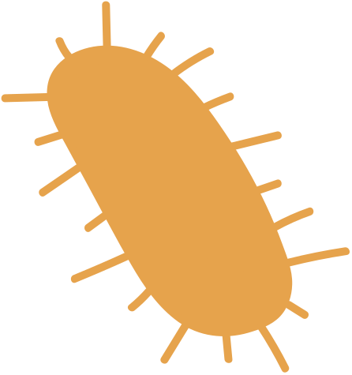
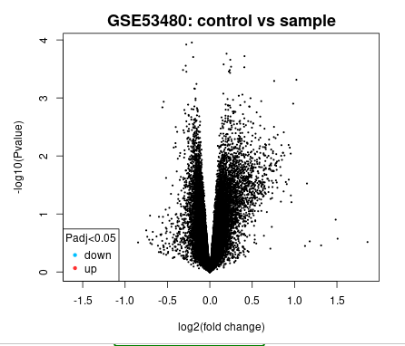
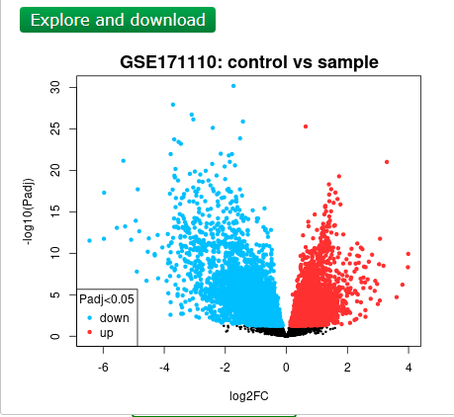

RESULTS
Volcano plots illustrate differentially expressed genes (DEGs) in Alzheimer's disease (GSE53480) and COVID-19 (GSE171110), highlighting significant upregulated (red) and downregulated (blue) genes based on adjusted p-values (< 0.05). These plots reveal key transcriptional changes in Tg4510 mice and severe COVID-19 cases.

Slide 7
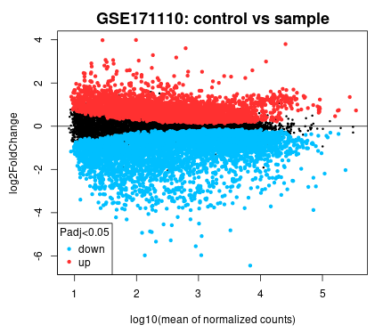
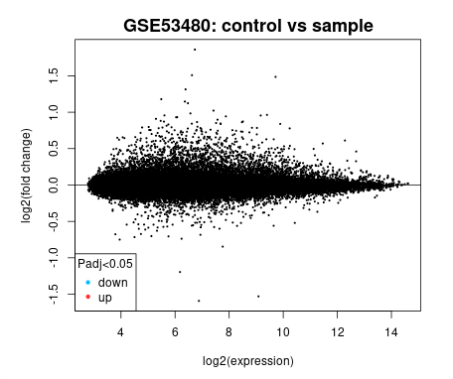
RESULTS
Bland-Altman plots for datasets GSE53480 (Alzheimer's) and GSE171110 (COVID-19) highlight significant DEGs (Padj < 0.05) based on mean expression differences (log2 fold change). These plots provide insights into consistent gene expression variations between conditions.

Slide 8
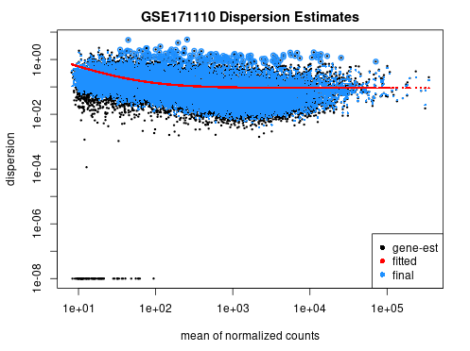
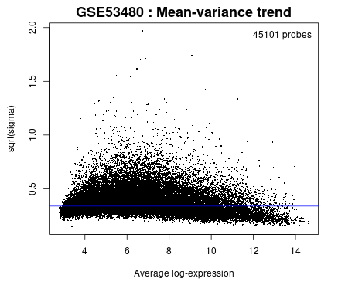
RESULTS
A mean-variance plot shows the relationship between mean gene expression levels and variability in RNA-seq and microarray data.
High-variance genes display notable expression differences across samples, while low-variance genes show consistent expression.

Slide 9
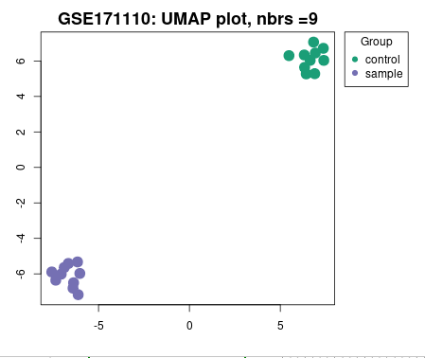
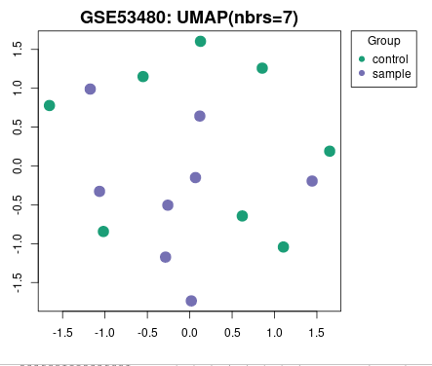
RESULTS
UMAP plots show control (green) and disease (purple) samples clustering by gene expression patterns, with separation indicating transcriptional differences.
The spatial organization reflects sample similarity, aiding in understanding group differences and experimental classification.

Slide 10
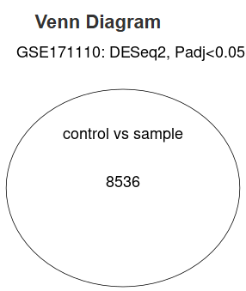
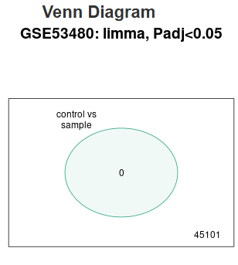
RESULTS
Venn diagrams visualize overlaps and unique DEGs between datasets, with shared genes in overlapping sections and dataset-specific genes in separate areas. This highlights commonalities and differences in gene expression.

Slide 11
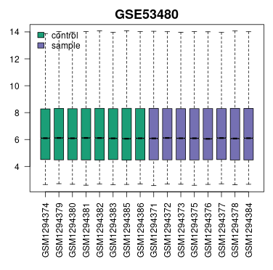
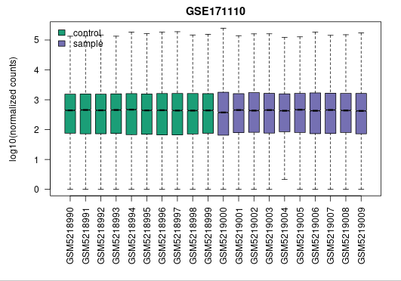
RESULTS
The Box plot for each dataset provides insights into the data's central tendency, variability, and potential outliers.

Slide 12
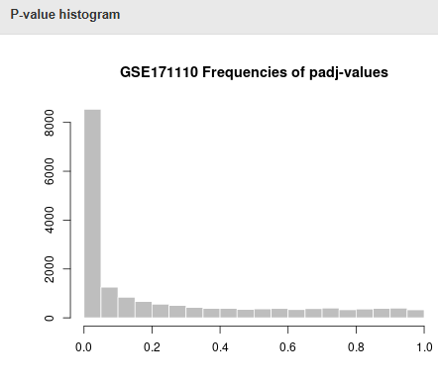
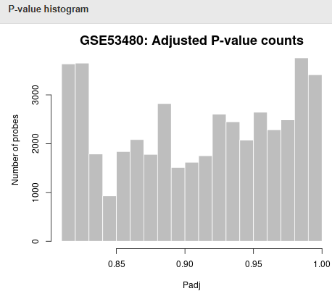
RESULTS
These figures show p-values from statistical tests are distributed throughout a dataset. x-axis shows the range of p-values.
The frequency or count of p-values inside each bin is shown on the y-axis

Slide 13


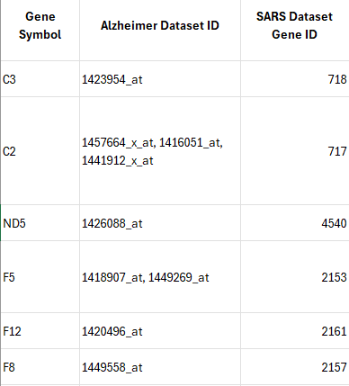


R ANALYSIS result
Key shared genes between COVID-19 and Alzheimer's disease (AD) include C3, C2, ND5, F5, F12, and F8. These genes play roles in inflammation, coagulation, and oxidative stress, contributing to hyperinflammation, vascular injury, and tissue damage in COVID-19, as well as neuroinflammation, plaque development, and neuronal dysfunction in AD. Their dysregulation highlights common pathological mechanisms across both diseases.

Slide 14

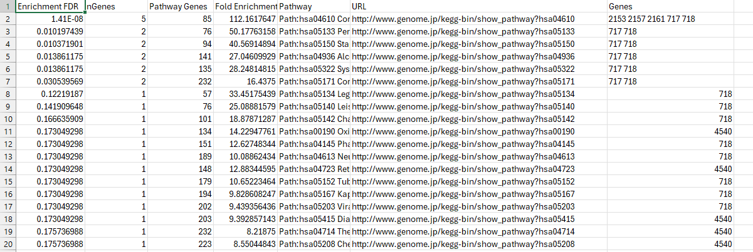

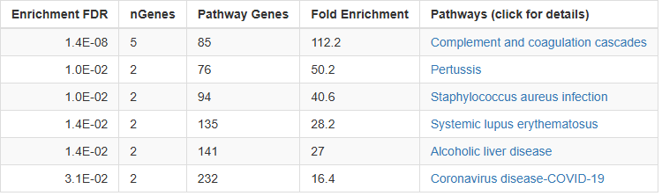

ENRICHMENT
ANALYSIS
WITH
SHINY GO

Slide 15
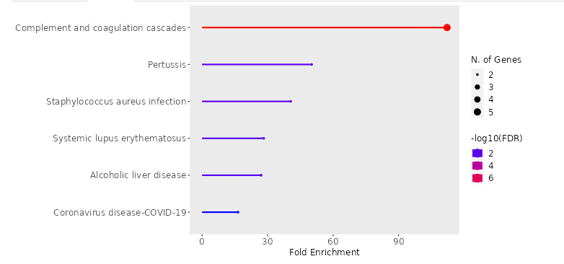
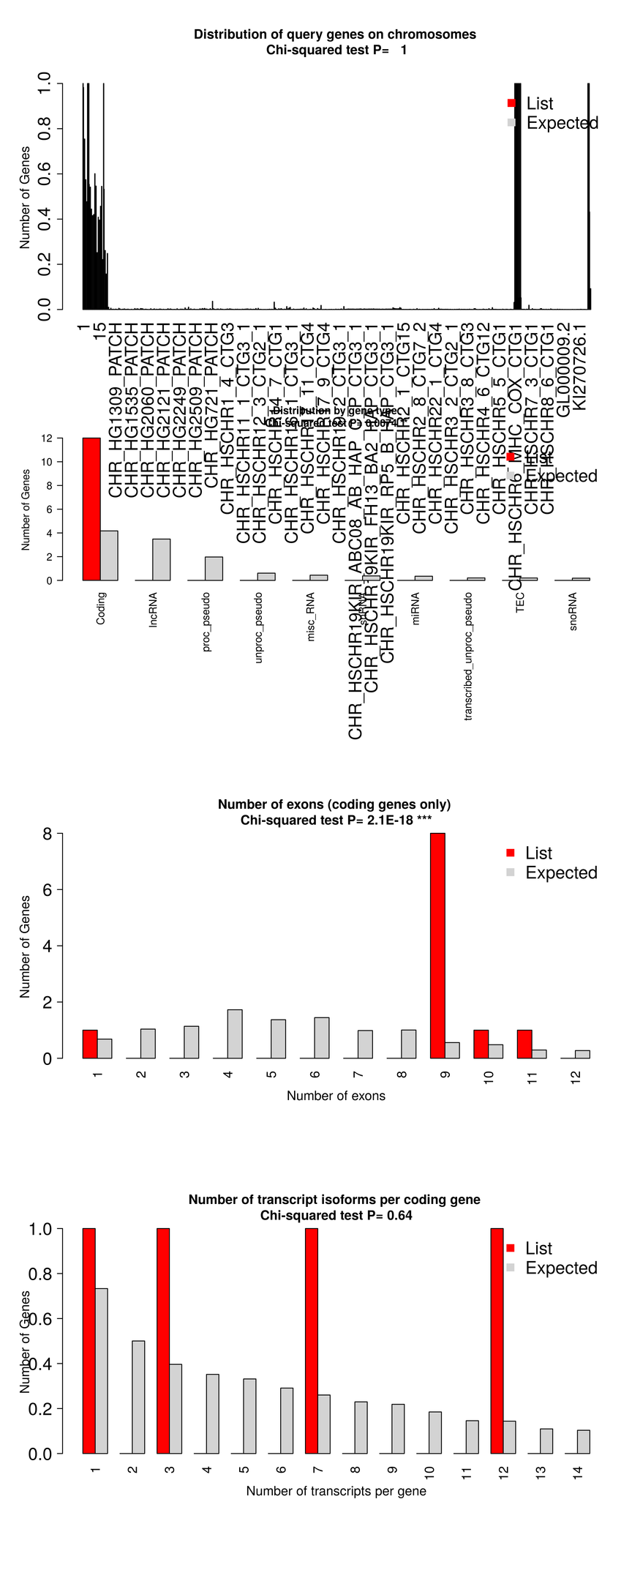
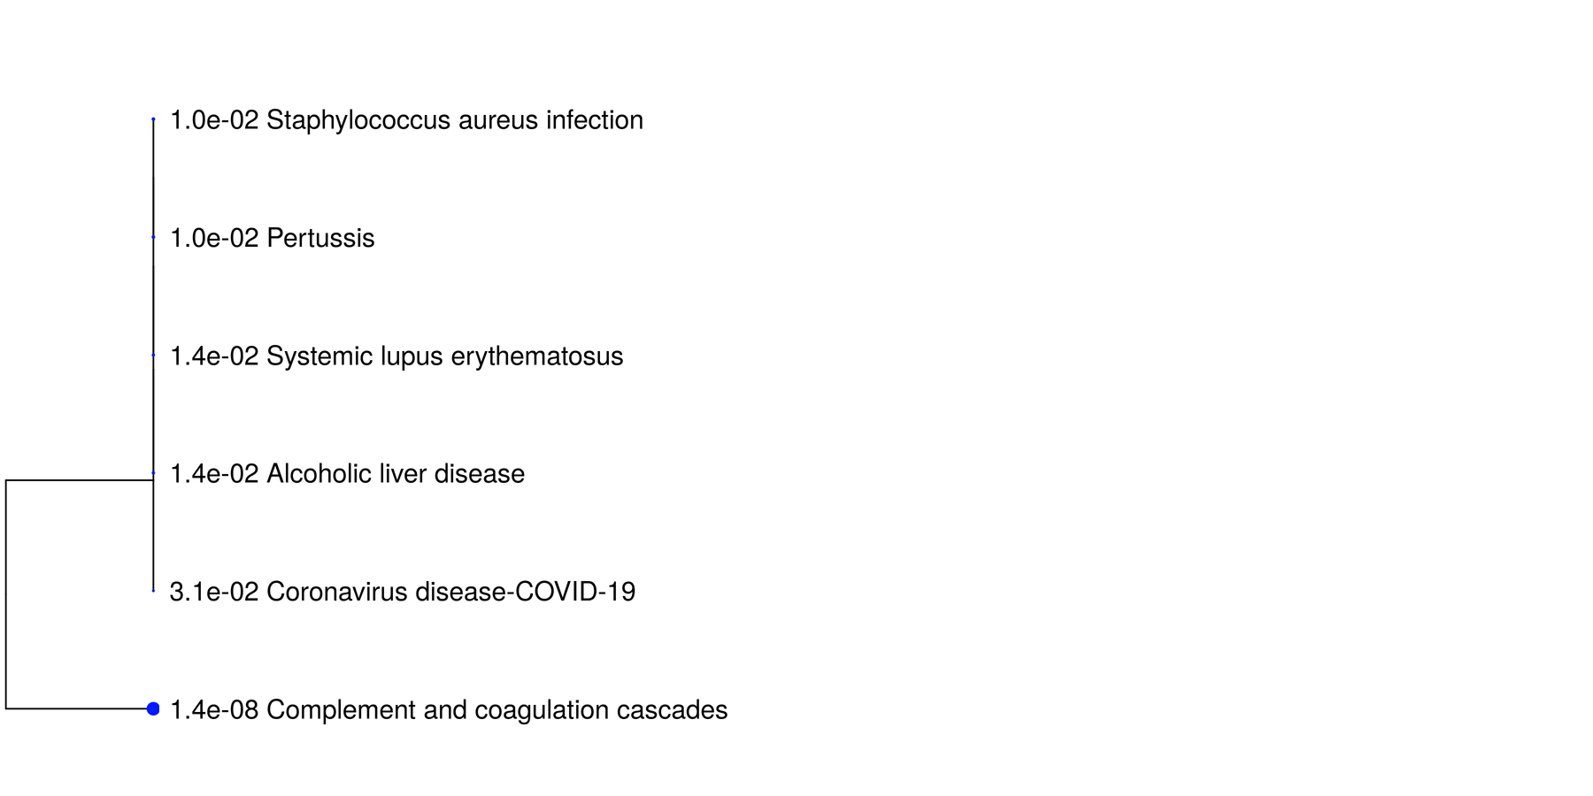
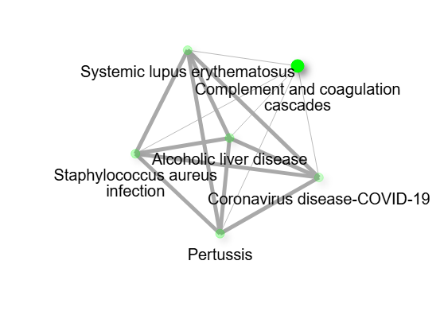
ENRICHMENT
ANALYSIS

Slide 16
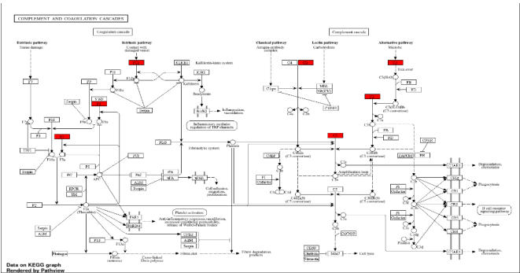
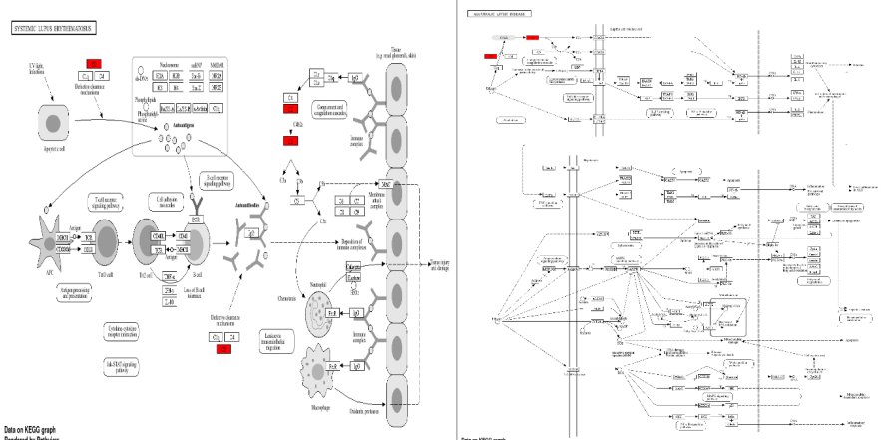
KEGG PATHWAYS
Systematic lupus and Alcoholic liver
Cascade pathway

Slide 17
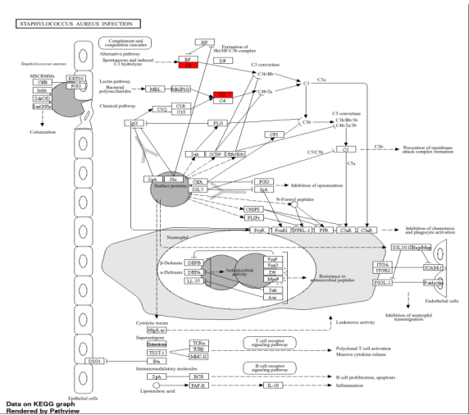
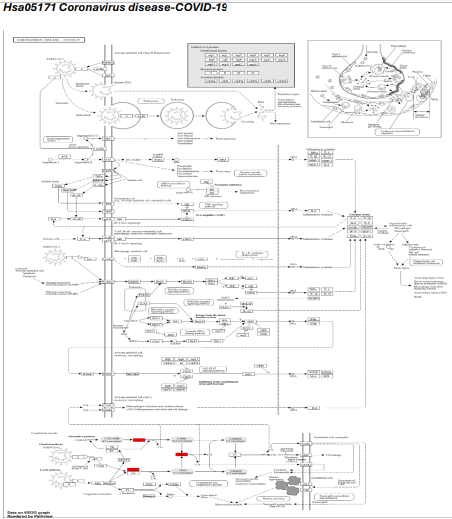
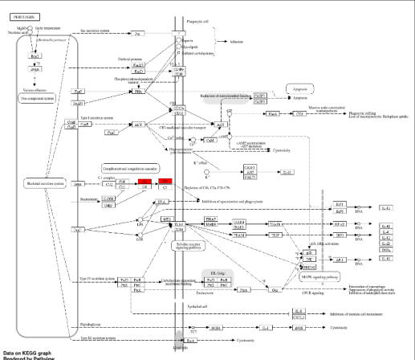
Staphelococcus infesction
PATHWAYS
Pertussis
Corona Virus

Slide 18
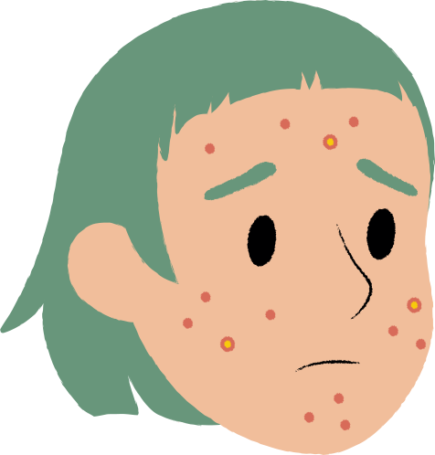
KEGG PATHWAY
Enrichment analysis reveals that genes C3, C2, F5, F12, F8, and ND5 play significant roles in pathways linked to immune responses, inflammation, and mitochondrial dysfunction, key contributors to neurodegenerative diseases like Alzheimer's and Parkinson's. The Complement and Coagulation Cascades pathway (hsa04610) showed the strongest association (FDR = 1.4E-08, fold enrichment = 112.2), implicating these genes in neuroinflammation and immune dysregulation. Pathways like Pertussis, Staphylococcus aureus infection, and Systemic Lupus Erythematosus highlight the roles of complement proteins in immune defense and autoimmune conditions. ND5's involvement in mitochondrial pathways underscores its relevance to neurodegeneration through energy deficits and oxidative stress, linking it to diseases like Parkinson’s and Huntington’s. These findings emphasize the interplay between immune and mitochondrial dysfunction in neurodegenerative and inflammatory diseases.

Slide 19





THE CORROLATION
SARS-CoV-2 infection and Alzheimer's disease share pathological mechanisms, including immune dysregulation, chronic inflammation, vascular dysfunction, and mitochondrial impairment. Key factors like complement activation (C3, C2), coagulation dysfunction (F5, F12, F8), and mitochondrial dysregulation (ND5) contribute to neuroinflammation, oxidative stress, and neuronal damage in both conditions. Severe COVID-19 may accelerate or increase the risk of AD progression in vulnerable individuals.

Slide 20


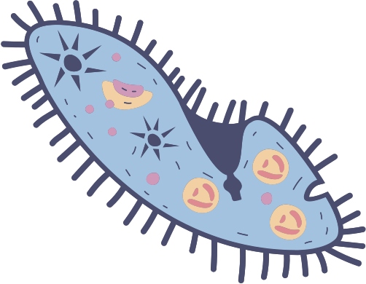

DISCUSSION
Genetic Intersection and Implications
Shared genetic factors between SARS-CoV-2 and Alzheimer's Disease (AD): C3, C2, ND5, F5, F12, F8.
Complement system genes (C3, C2): Mediate inflammation and immunity, contributing to neuroinflammation in AD and cytokine storms in SARS-CoV-2.
Mitochondrial dysfunction (ND5): Links oxidative stress and energy deficits in both diseases.
Coagulation-related genes (F5, F12, F8): Indicate shared vascular dysfunction and thrombotic complications.
SARS-CoV-2-induced inflammation may accelerate neurodegenerative processes.

Slide 21
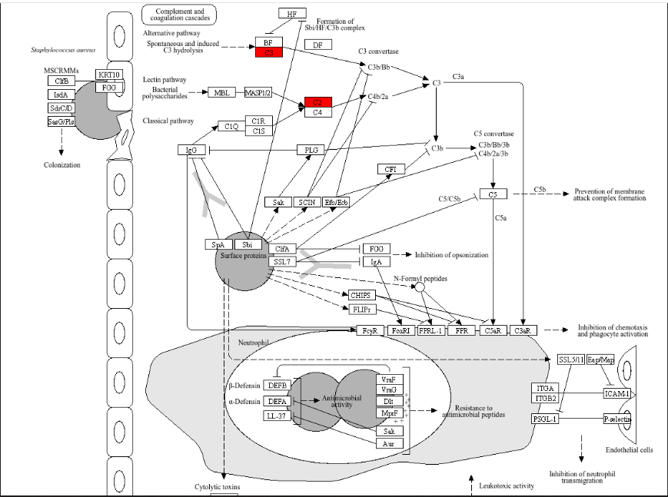
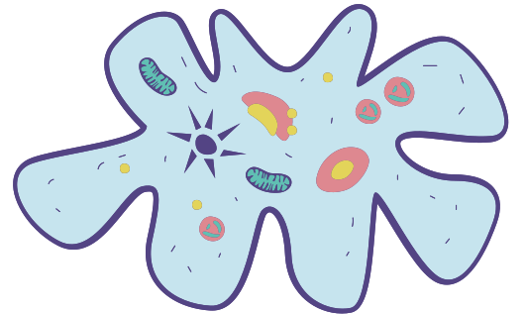
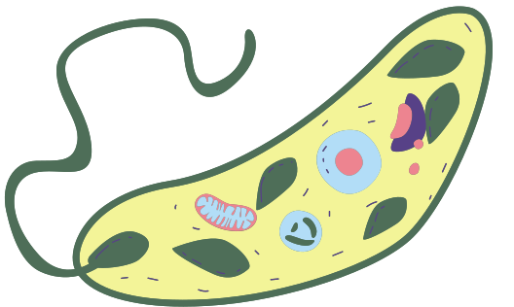

PATHWAY ENRICHMENT INSIGHTS
KEGG Pathways
Complement and Coagulation Cascades (hsa04610): Links immune dysregulation to systemic and neural damage.
Mitochondrial dysfunction (ND5): Connects viral infections to neurodegeneration.
Coronavirus Disease Pathway (hsa05171): Shows viral-mediated immune activation driving neuroinflammatory pathways.

Slide 22



THERAPEUTIC IMPLICATIONS
Complement system inhibitors (targeting C3): Reduce inflammation and neuronal damage.
Mitochondrial function enhancement (e.g., ND5-targeting antioxidants): Mitigate oxidative stress.
Coagulation regulation (F5, F12, F8): Manage vascular complications with anticoagulants or modulatory drugs.
Therapies require personalized approaches for systemic and chronic disease impacts.

Slide 23
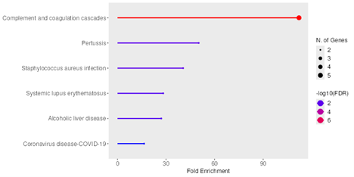






FUTURE RESEARCH DIRECTIONS
Conduct longitudinal studies: Monitor cognitive decline and biomarkers in post-COVID-19 patients.
Perform molecular validation: Confirm roles of shared genes (C3, C2, ND5, F5, F12, F8).
Explore drug repurposing: Leverage existing anti-inflammatory and mitochondrial therapies for dual targeting of AD and SARS-CoV-2.

Slide 24
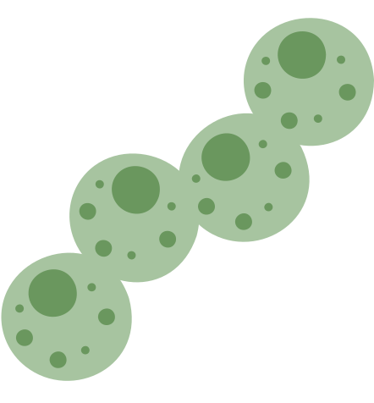

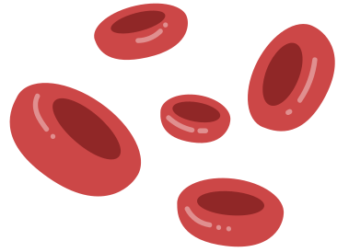


CONCLUSION
The study uncovers shared genetic and molecular links between SARS-CoV-2 and Alzheimer's disease, highlighting pathways like coagulation and mitochondrial dysfunction. It suggests targeting these pathways to develop effective therapies and stresses the need for further research and drug repurposing.

